Slide 1
Series Hybrid Drive Train
Dr. Sachin Argade

Slide 2
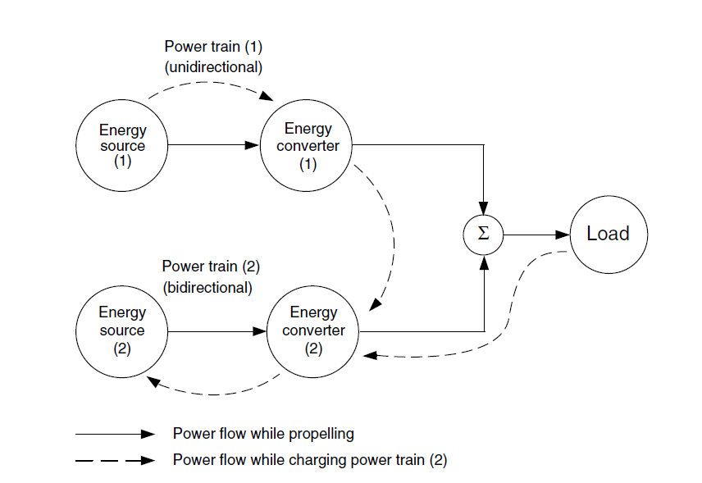
Basic architecture of hybrid drive train

Slide 3
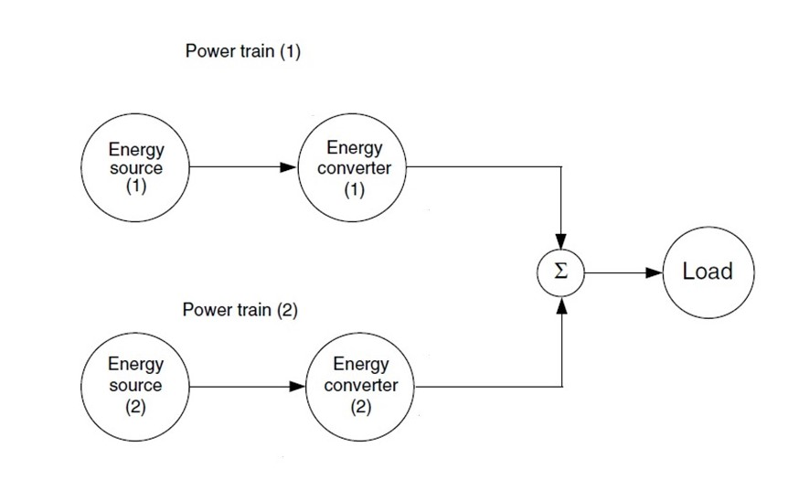
Basic architecture of hybrid drive train
Power train 1 alone delivers power to the load
Power train 2 alone delivers power to the load
Both power train 1 and 2 deliver power to load at the same time
Power train 2 obtains power from load (regenerative braking)
Power train 2 obtains power from power train 1
Power train 2 obtains power from power train 1 and load at the
Power train 1 delivers power to load and to power train 2 at the
Power train 1 delivers power to power train 2, and power train 2
delivers power to load
Power train 1 delivers power to load, and load delivers power to
power train 2.

Slide 4
The varied operation modes in a hybrid vehicle create more flexibility over a single power train vehicle.
With proper configuration and control
applying the specific mode for each special operating condition
can optimize overall performance, efficiency, and emissions.

Slide 5
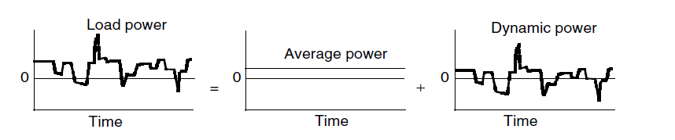
The load power of a vehicle varies randomly in real operation
due to frequent acceleration, deceleration, and climbing up and down grades
Actually, the load power is composed of two components:
one is steady (average) power, which has a constant value,
other is dynamic power, which has a zero average

Slide 6
Hybrid Power Train
In hybrid vehicle strategy,
one power train that favors steady-state operation, such as an IC engine (smaller sized than single power train system)
fuel cell, can be used to supply the average power.
On the other hand,
power trains such as an electric motor can be used to supply the dynamic power.
The total energy output from the dynamic power train will be zero in a whole driving cycle.
Implies that the energy source of the dynamic power train does not lose energy capacity at the end of the driving cycle

Slide 7
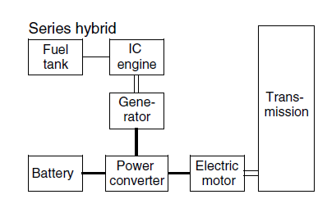

Series Hybrid mode

Slide 8
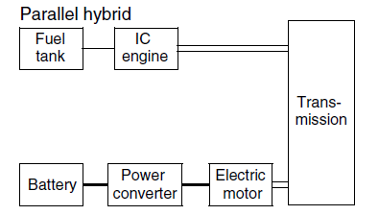
Parallel Hybrid Mode

Slide 9
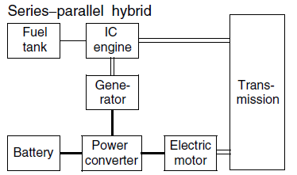
Series Parallel Hybrid

Slide 10
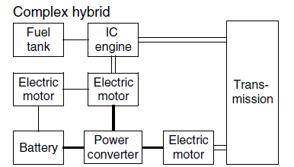
Complex Hybrid Mode

Slide 11
1. Definition of Series Hybrid
In a series hybrid, the internal combustion engine does not mechanically drive the wheels.
All propulsion torque is generated by the electric motor.
Energy path: Fuel → Engine → Generator → DC Bus → Motor → Wheels.

Slide 12
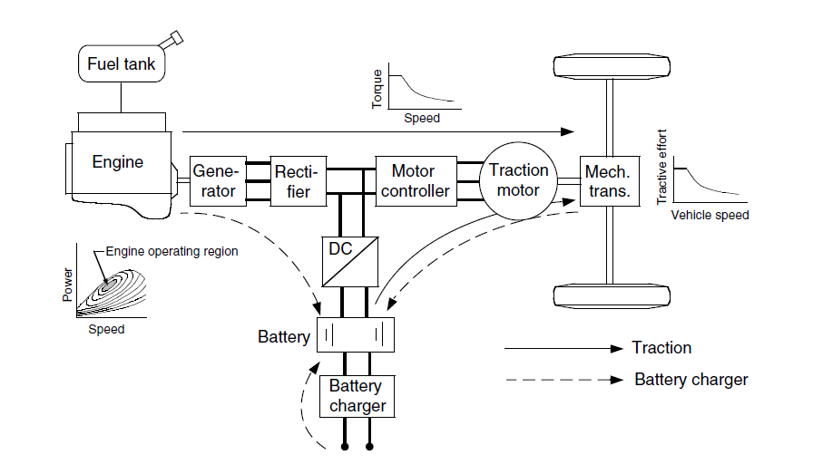

Slide 13
2. Energy Conversion Stages
Stage 1: Chemical → Mechanical (Engine).
Stage 2: Mechanical → Electrical (Generator).
Stage 3: Electrical → Mechanical (Motor).
Each stage introduces efficiency loss.

Slide 14
3. Engine Efficiency Equation
η_e = Brake Power / Fuel Energy Input.
η_e = P_engine / (ṁ_f × LHV).
η_e ​ = Engine Efficiency Dimensionless (no units)
Typical petrol engine: 30–35%
Typical diesel engine: 35–45%
P_engine = Brake Power Output (W or kW)
Actual mechanical shaft power available at crankshaft
Measured using dynamometer
Also called Brake Power (BP)
ṁ_f = Fuel Mass Flow Rate (kg/s)
Rate at which fuel is consumed
Measured in kg/s
LHV = Lower Heating Value (J/kg)
Energy released per kg of fuel during combustion
Does NOT include latent heat of vaporization
Typical range: 0.30–0.38 for gasoline engines.

Slide 15
4. Generator Efficiency
η_g = Electrical Output / Mechanical Input.
η_g = P_electric / P_engine_shaft.
Typical efficiency ≈ 0.90–0.95.
5. Motor Efficiency
η_m = Mechanical Output / Electrical Input.
η_m = P_wheel / P_dc.
Motor and inverter losses considered together.

Slide 16
6. Cascaded Efficiency
Let fuel power = P_f.
Engine output = η_e x P_f.
Generator output = η_g x η_e x P_f.
Wheel output = η_m x η_g x η_e x P_f.
7. Overall System Efficiency
η_total = P_wheel / P_fuel.
η_total = η_e × η_g × η_m.

Slide 17
9. Interpretation of Losses
Approximately 71% of fuel energy lost as heat and conversion losses.
Major loss occurs in combustion stage.
10. Wheel–Fuel Power Relation
From η_total = P_w / P_f.
Fuel power required: P_f = P_w / η_total.

Slide 18
11. Numerical – Fuel Requirement
If P_w = 60 kW and η_total = 0.29,
P_f = 60 / 0.29 ≈ 206.9 kW.
12. DC Bus Power Requirement
Motor electrical power: P_dc = P_w / η_m.
Accounts for inverter and motor losses.

Slide 19
13. Power Balance on DC Bus
P_dc = P_gen + P_bat.
Battery assists when generator output insufficient.
14. Numerical – Battery Assist
If P_w = 70 kW, η_m = 0.90 → P_dc = 77.8 kW.
If generator supplies 50 kW, battery supplies 27.8 kW.

Slide 20
15. Battery Charging Condition
If generator power exceeds P_dc demand, Excess energy charges battery.
P_bat becomes negative (charging mode).
16. SOC Dynamic Equation
SOC(t) = SOC_initial − (1/C) ∫ I_bat dt.
SOC maintained typically between 40–80%.
17. Battery Energy Calculation
Energy stored E = V × Ah.
Example: 300 V × 40 Ah = 12 kWh battery pack.

Slide 21
18. Acceleration Analysis
During acceleration, peak power > engine rated power.
Battery provides transient support.
Allows engine downsizing.
19. Engine Downsizing Principle
Engine sized for average power demand.
Battery supplies peak demand.
Improves fuel economy and reduces weight.

Slide 22
20. Regenerative Braking Energy
Kinetic energy: E = 1/2 m v².
Recovered energy depends on regeneration efficiency.
21. Numerical – Kinetic Energy
For m = 1500 kg, v = 25 m/s,
E = 0.5 × 1500 × 625 = 468,750 J (468.75 kJ).
22. Energy Recovery Calculation
If regeneration efficiency = 60%,
Recovered energy = 0.6 × 468.75 = 281.25 kJ.

Slide 23
23. Regenerative Power Equation
P_regen = T × ω.
Limited by motor current and battery acceptance rate.
24. Regeneration Constraints
Battery current limit.
High SOC condition.
Low-speed inefficiency.

Slide 24
25. Thermal Efficiency Optimization
Operate engine at optimal BSFC region.
BSFC = Brake Specific Fuel Consumption
It is a measure of how efficiently an engine uses fuel to produce useful power.
On a typical engine map (BSFC contour map):
X-axis → Engine Speed (RPM)
Y-axis → Engine Torque (Nm)
Contour lines → BSFC values (g/kWh)
The lowest BSFC contour (smallest number) forms a “sweet spot” island.
This is the optimal BSFC island.

Slide 26
Why Does BSFC Change With RPM & Load?
Engine efficiency depends on:
Low Load (Bad Efficiency)
Throttle losses
Pumping losses
Friction dominant
BSFC high
Very High RPM (Bad Efficiency)
Friction losses increase
Combustion not ideal
BSFC increases
Medium RPM + High Load (Best Efficiency)
Reduced throttling
Better combustion pressure
Lower relative losses
Minimum BSFC
This region is called: Optimal BSFC region

Slide 27
Why Optimal BSFC Region Is Very Important in Series Hybrid?
In a conventional car:
Engine speed depends on vehicle speed.
Cannot stay in optimal region continuously.
In a Series Hybrid:
Engine is decoupled from wheels Engine can run at fixed RPM Operates near optimal BSFC island
This is a major advantage.

Slide 28
26. Urban Drive Cycle Analysis
Frequent braking improves energy recovery.
Series hybrid performs best in stop–go traffic.
27. Highway Drive Cycle Limitation
Multiple conversion losses reduce highway efficiency.
Parallel systems better at constant high speed.

Slide 29
28. Loss Distribution Analysis
Largest Engine combustion losses.
Electrical losses smaller but cumulative.
29. Design Trade-Off Analysis
Large motor required.
Higher cost due to generator and power electronics.
Improved urban fuel economy.

Slide 30
30. Summary
η_total = η_e x η_g x η_m governs performance.
Battery enables transient power and regeneration.
Series hybrid ideal for city conditions like Pune.

